Slide 1
Trauma 101
what it is…
why it matters…
and how to be…
Trauma-Informed
Notes:
Key for Trainer Notes:
Bold: Key Ideas, points of emphasis, questions for audience.
Underlined: Video Directions/Links and suggested run times.
Italics: Trainer notes not to be spoken out loud, directions for modifications depending on audience.
Underlined Italics: Additional links/resources for information.

Slide 2
Please take notice of self, other, community and the world.
TICI of WNY
Notes:
Trainer:
Ask question slowly.
For small group, identify where they are from and gain some background knowledge.
Discuss recent events in the world or local community that individuals are connected to make comment to event. (trauma or injustice events)
Mention of it without inviting dialog but honoring that it has occurred.

Slide 3
What is it that you know about the impact of adversity and trauma on individuals and communities?
TICI of WNY
Notes:
Trainer:
Ask question slowly.

Slide 4
Self and World View
“The world is an unsafe place to live.”
“Other people are unsafe and can’t be trusted.”
“My own thoughts and feelings are unsafe.”
“I have no self-worth and no abilities.”
“I expect crisis, danger, and loss.”
TICI of WNY
Notes:
Trainer:
We have learned that most people by the age of about ten have a sense of who they are in comparison to others around them. This is the age where we establish our core beliefs which are a sense of self, other, and the world as a whole. This “world view” may be impacted by the trauma people undergo.
These are some examples of the beliefs that individuals who have experienced trauma hold about the people and the world around them. If we can really understand the events that a person has experienced, then we can understand the reasons why they lack trust and feel unsafe. Therefore, the more negative experiences a child has, higher the chance to have negative thoughts about themselves and the world.
Examples of these negative self and world views are:
“The world is an unsafe place to live.”
“Other people are unsafe and can’t be trusted.”
“My own thoughts and feelings are unsafe.”
“I expect crisis, danger, and loss.”
“I have no self-worth and no abilities.”

Slide 5
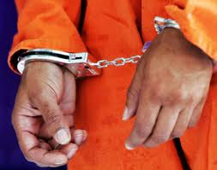
Overview
TICI of WNY
Notes:
Trainer:
This presentation covers sensitive topics surrounding trauma, and Adverse Childhood Experiences (ACEs). If you notice yourself becoming distressed, please take a break, and come back to the material when you are ready. Trauma-informed care and it’s five guiding core principles will be discussed at the end of the presentation.
Some of the conversations we will be having today will be focused on the experience of trauma and re-traumatization which may impact many of us in the room. We need to ensure the emotional safety of all of those when sharing this information. Getting into specific details about trauma may be traumatizing for some, so please be aware that sharing personal experiences may be triggering for some.
** A Note about Emotional Safety
Given the nature of this training, it is important for trainers to set expectations about ensuring emotional safety of everyone in the room.
Trainers are also asked to directly let participants know that although some of the conversations today will be focused on the experience of trauma and re-traumatization (which may impact many of us in this room), we also need to consider the emotional safety of everyone when sharing.
Getting into the specific details about traumatic events and experiences that you had may be triggering not only for yourself, but also others in the room. Therefore, the facilitator asks that when participants share their experiences, to “skip the stone”—in other words, they can acknowledge trauma has happened and then focus on the point they would like to make/share—please do not get into the details and “sink the stone.”

Slide 6
Post-Traumatic Stress Disorder “After” “Trauma” “Anxiety” “Reaction”
Those with PTSD…
Have survived or witness a traumatic event
Have intense feelings of helplessness, fear, or horror
Experience difficulties expressing of positive emotions
Are socially withdrawn
Have intrusive thoughts
Have a dreamlike, distant, and/or distorted worldview
Are lower functioning
Experience prolonged psychological distress
Have distressing dreams
Have distressing memories
Avoid external stimuli
Experience hypervigilance
TICI of WNY
Notes:
Trainer:
Post-Traumatic Stress Disorder (PTSD) is a diagnosis that was originally used for soldiers returning from war. This diagnosis has been expanded to many other individuals who experience significant trauma. On the slide are some of the characteristics of those who have PTSD.

Slide 7
Acute Stress Disorder
Those with ASD…
Have survived or witness a traumatic event
Experience distressing memories of traumatic events
Have reoccurring distressing dreams in relation to event
Have an inability to remember important aspects of traumatic events
Have an inability to experience positive emotions
Have an altered sense of reality
Have sleep disturbances
Experience hypervigilance
Have problems with concentration
Disturbance not attributed to the physiological effects of a substance
TICI of WNY
Notes:
Trainer:
Those with ASD have some overlapping symptoms with PTSD. Here are some of the characteristics of those with ASD.

Slide 8
The Impacts may be felt…
Physically
Emotionally
Cognitively
Spiritually
Behaviorally
TICI of WNY
Notes:
Trainer:
Consider for one moment how you personally have been affected by a stressful event or crisis…Think about how you might feel during or after a crisis…Then imagine how you might feel if the crisis was ongoing…
A state of constant stress prohibits development. This constant stress can have impacts in five different areas. Physical, emotional, behavioral, cognitive, and spiritual.
First, adversity and trauma may physically impact the brain and body. The brain may develop maladaptive ways to manage these trauma responses, and the brain will be in a heightened state of stress during normal circumstances. The body may also be impacted. Common bodily sensations include stomach distress and headaches, as well as pain dysregulation, whether that’s over or under experiencing physical pain.
From an emotional standpoint, individuals may have unpredictable or explosive moments. They may internalize or externalize their emotions. They may feel a sense of powerlessness that leads to defensiveness and over reacting behavior. Moreover, individuals may disassociate and develop self-harming behaviors.
Disassociation also applies in a cognitive standpoint. Individuals begin to feel detached from the self and feel as though they are living as two separate people. Their ability to think clearly, reason and problem solve may also be significantly impacted as well. They may have attention loss/difficulties too.
Individuals who experience trauma and chronic stress may also have negative impacts on their spiritual health as well. This may impact their spiritual identity as a whole.
When chronic trauma occurs in infancy or childhood, it can confuse our nervous system…this can result in “frozen fear.” People become emotionally frozen, numb and removed from reality. This has huge effects on coping as adults as our central nervous system begins to fight itself and regulating hormones become trapped or blocked.

Slide 9
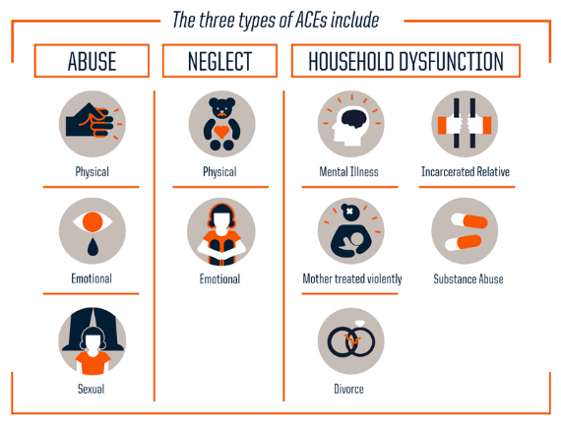
Adverse Childhood Experiences (ACEs)
The ACE Study
(Adverse Childhood Experiences)
Joint study conducted by the Kaiser Institute of San Diego and the Center for Disease Control (CDC)
Analyzes the relationship between:
Multiple categories of childhood adversity (prior to age 18).
Health and behavior outcomes over someone’s lifespan.
(The Center for Disease Control and Prevention, 2015)
TICI of WNY
Notes:
Trainer:
The ACE Study
(Adverse Childhood Experiences)
Joint study conducted by the Kaiser Institute of San Diego and the Center for Disease Control (CDC)
Analyzes the relationship between:
Multiple categories of childhood adversity (prior to age 18).
Health and behavior outcomes over someone’s lifespan.
The ACE study evolved out of a collaborative relationship between the CDC and the Kaiser Permanente Medical Care Program in the 1990’s. Adverse childhood experiences have a tremendous impact on future violence victimization and perpetration and lifelong health and opportunity. These impacts can be shown in the visual on the slide. This video from PBS explains a brief overview of ACEs
Adverse Childhood experiences or ACEs are defined as life events that lead to negative outcomes. There are three categories of ACEs to consider: Abuse, Neglect, and Household Dysfunction/Loss.
Adversity is different than trauma. People can experience adversity and not be traumatized, however others may have trauma. What makes trauma is person’s perspective of what happened. There are also different types of adversity. Adversity can be perceived as traumatic, but adversity does not equal trauma.
Adversity is a normal part of life and many people do not have adverse reactions to these life events. For example, some individuals may have their parents go through a divorce, and feel no adverse reactions, while others may be significantly impacted by that event.
The study assesses the long-term impact of multiple types of abuse and household dysfunction during childhood on the following outcomes in adults:
1. Disease risk factors
2. Quality of Life
3. Healthcare utilization and mortality
The more ACEs an individual has, the greater the risk for:
1. Poor health outcomes
2. Mental health problems
3. High risk behaviors
The main take away is that ACEs have the potential to reduce an individual’s life span and lead to negative life outcomes.
Examples of Childhood trauma are:
- Physical and/or emotional abuse by a parent
- Sexual abuse by anyone
- Growing up with an alcohol and/or drug abuser in the household
- Domestic violence
- Incarceration of a household member
- Living with a family member experiencing mental illness/suicidality
- Loss of a parent (divorce or separation were measured in the study, not death)
- Physical and/or emotional neglect

Slide 10
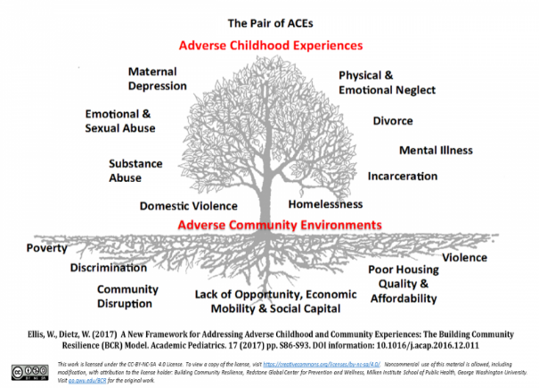
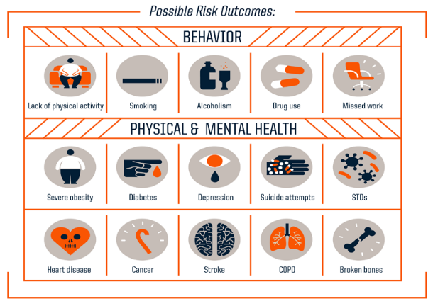
Adverse Childhood Experiences (ACEs)
(The Center for Disease Control and Prevention, 2015)
TICI of WNY
Notes:
Trainer:
Goes into providers

Slide 11
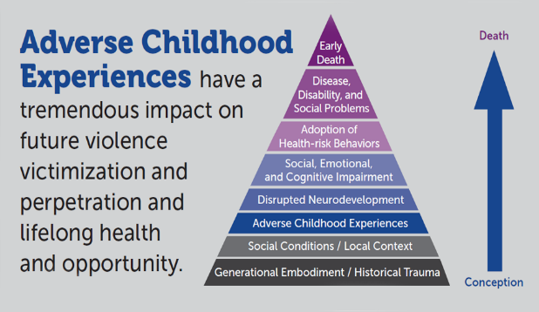
Impacts of ACEs
Dr. Vincent Felitti
Internist & ACE study co-author
Kaiser Permanente
Roxy Foster
Director of Prevention Initiatives
Minnesota Communities Caring for Children
Janelle Kendal
Sterns County Attorney
ACEs Overview Video Link
(Center for Disease Control and Prevention, 2019)
TICI of WNY
Notes:
Trainer:
In the following video, you will hear from Dr. Vincent Felitti, the ACEs study co-author at the Kaiser Permanente. Roxy Foster, the director of prevention Initiatives at the Minnesota Communities Caring for Children, and Janelle Kendal, a Stearns County Attorney. The study was led by Dr. Vincent Felitti, a well known and well published physician and researcher. These impacts can be shown in the visual on the slide. This video from PBS explains a brief overview of ACEs:
Click (ACEs Overview Video Link) to activate hyperlink (3 minutes and 40 seconds).
For those reading along, right click link if not in “presentation” mode and scroll to “hyperlink”. Click open to activate link.
The CDC website is good for general information and for links to other ACE related websites.
Additional Resources:
www.cdc.gov/ace/‎
ACERESPONSE.ORG - ACE Response grew out of a partnership between Prevent Child Abuse America and the University at Albany (SUNY) School of Social Welfare.*
ACESTUDY.ORG
https://www.pbs.org/video/aces-overview-35403/
We recommend that people delivering this PowerPoint familiarize themselves with these websites so that they can speak comfortably about it. Based on any given audience people may want more about ACEs.*

Slide 12
Overwhelming one’s ability to cope
Impairs one’s ability to integrate…
Experiences, Ideas and Emotions
with life events.
TICI of WNY
Notes:
Trainer:
Traumatic events like this can overwhelm people’s ability to cope with daily stressors, but trauma impacts everyone differently. The person’s perception of what happened and how they contextualize it both matter. Perception is EVERYTHING.
Example of “individual difference”:
“Lets say myself and another individual get into separate car accidents. However, the accidents were virtually identical. I may be able to return to driving that same day, but another person may experience fear and anxiety surrounding the event. The car accident may not have impacted me, but the other person may develop stress responses due to that event that impact their experiences, ideas and emotions.”
Traumatic events can be more than just “upsetting” to someone. Biological changes take place and affect how people cope and react in situations based on past experiences. I’m sure everyone has heard of the “fight or flight response”. There is also something called the “freeze” response which has been linked to trauma memory for individuals. Think of a “deer in the headlights”. We will go into these responses in a later slide.

Slide 13
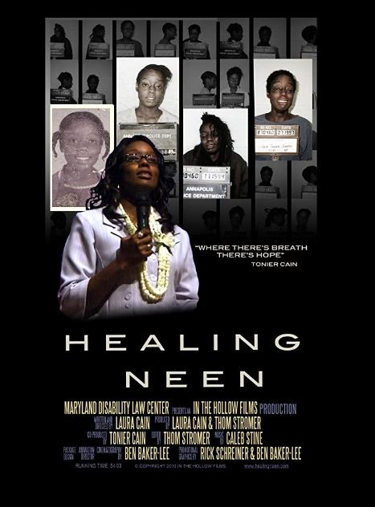
Trauma is real…
The Story of Tonier “Neen” Cain.
Documentary Trailer Link
TICI of WNY
Notes:
Trainer:
Trauma is real and it’s impacts can be shown in this documentary. This trailer introduces us to Tonier “Neen” Cain, a trauma survivor. Some material may be difficult to watch.
Play video clip (3 minutes and 20 seconds).
Neen was able to overcome her traumatic past, and now she spends time sharing her story with others. Some may be inspired by her story and know that there are ways to overcome trauma. The entire Documentary is uploaded to YouTube, or you can visit: http://www.healingneen.com.
Note that this documentary is heavy, make sure there is time and space to take care of yourself and your emotional safety while viewing and/or showing others.
Ask audience for feedback.
“What did you notice from this trailer?” (You can heal, and you’re not alone) (Most people are resilient after experiencing adversity or trauma)
“What did Neen say that made a difference for her?” (you can heal)

Slide 14
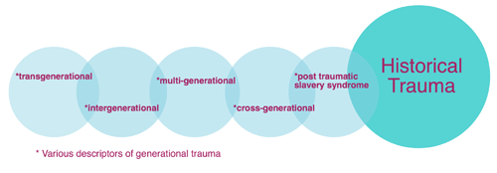
Historical Trauma
Decedents of those who have trauma histories may also experience trauma reactions.
People can become “transformed” by their traumatic experiences .
Whole cultural groups may become impacted.
These biological transformations may now be described as PTSD and Complex PTSD (for prolonged traumas).
For example, the genocide of a family’s ancestors may leave “soul wounds” for generations.
TICI of WNY
Notes:
Trainer:
Effects of trauma are felt as a ripple effect, people around those who have experienced trauma feel the effects as well. The wounds and consequences of trauma exposure affect subsequent generations.
Collective experience of trauma by a group of people with shared identity, affiliation, or circumstance across generations.
An example of historical trauma is described by researchers Gillson and Ross (2019) in their article, “From generation to generation: Rethinking ”soul wounds” and historical trauma.”
“Each year, members of the Lakota tribe and their allies gather in Bridger, South Dakota, and travel more than 300 kilometers on horseback in the dead of winter. The conditions are harsh: wind and snow burn their faces and make it difficult to breathe.
They travel to commemorate the journey of their ancestors. After the killing of Chief Sitting Bull by the U.S. Cavalry, Chief Big Foot led approximately 350 Lakota, mostly women and children, on what he hoped would be a journey to the safety of the Pine Ridge Reservation. Instead, they were intercepted by the U.S. Army. Their group submitted peacefully and made camp along Wounded Knee Creek.
On the morning of December 29th, 1890 a shot rang out and chaos ensued. Those who tried to flee were pursued and executed by U.S. soldiers. Children who hid were coaxed to come out and were then killed (2). All told, more than 250 Lakota were massacred.
Although this tragedy took place more than 100 years ago, its impact remains. The ongoing pain—from the genocide of the Lakota and numerous other acts against Native American communities—has been described as a “soul wound” (3). It is what drives the Lakota horse riders in their search for both personal and communal healing. The past weaves intricately through modern life, and in some ways, communities are still trying to recover.”

Slide 15
The Second Pandemic: Racial Injustices
(Southern Poverty Law Center, 2017)
TICI of WNY
Notes:
Trainer:
The Corona Virus (COVID-19) continues to cause justified stress responses throughout the country and the world.
The virus is disproportionally impacting minority groups, specifically Black individuals, due to social, economic and societal barriers that still remain in our society.
This real historical oppression that is passed on throughout the generations is leading to heightened stress responses.
Implicit biases were highlighted in the news during the Hurricane Katrina and Hurricane Harvey disasters.
Implicit biases by the media outlets and community members still impact minorities today.
They may be more fearful for their lives due to these prejudices. The “Black Lives Matter” movement is a direct response to racism that is still pervasive in our society today.
Oppressive language matters and it is important to highlight these subconscious biases. They may not be meant to harm but they do.

Slide 16
Fear Responses
When we perceive something as a threat, the amygdala activates and generates a fear response—commonly referred to as the “fight, flight or freeze” or stress response.
(Burke-Harris, 2014; Klinic, 2013; Pessoa, 2011)
TICI of WNY
Notes:
Trainer:
For those who experience an event or ongoing situation as traumatic, biological changes take place and affect how people cope and react in situations based on past experiences. These impairments trigger one to…“Fight, Flight, or Freeze” to defend themselves. This would be the response when someone has a ”flipped lid”.
Many people are familiar with the basic “Fight or Flight” response to danger. If you are unaware, the fight response is to attack or fight against the stressor. The flight response is to run away or flee from the stressor. There is also something called the “freeze” response which has been linked to trauma memory for individuals. Think of a “deer in the headlights”.
Example: These responses can develop from both acute and chronic events.. Imagine you are walking in the forest and you see a bear. You may have one of these four responses. You could be ready to fight, have a flight response (get out of there), or freeze (deer in the headlights). Not all traumas are in that linear line and these responses may become more complicated with chronic events. If someone experienced prolonged domestic piece, sometimes someone even raising their voice is a trigger. The amygdala is activated all of the time in chronic events, and the body taught to be prepared all of the time.
These response, along with other fight, flight, freeze responses may be turned into strengths once the individual has learned to be managed by the individual.
Additional information on complex trauma response (“fawn response”)
The fawn response is the most complex trauma response. This is similar to empathy. Healthy empathy is when an individual is able to “tune in” or “feel” another person’s situation. The fawn, or “please” response takes that to the extreme. The individual gives up their sense of self, a sense of healthy identity and takes on responsibilities that are not theirs to carry. It may work in the short term, but in the end it causes one to experience tremendous amounts of pain. Most responses serve a purpose, they protect you. Can be hard to understand what purpose the freeze and fawn responses would have, but it is real, it does happen. More research is needed on the fawn trauma response as it is a new idea presented to the field.
The fawn response has little research associate with it. However, Kenneth Barish Reviewed Paul Bloom’s 2016 book titled, “Against Empathy: The case for Rational Compassion.” Both reviewed the same material, but came to very different conclusions. Bloom argues for rational compassion, while Barish argues that empathy and compassion are very different concepts. Barish states that “empathy is an essential nutrient of healthy emotional development in childhood and of successful interpersonal relationships throughout life”.

Slide 17
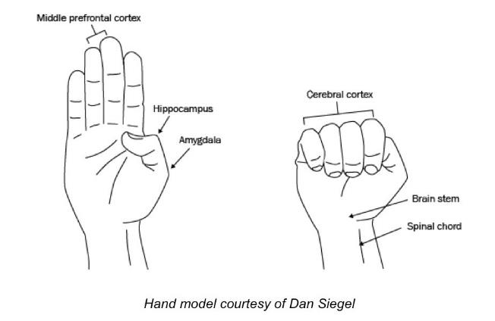
Impacts on the Brain
Dr. Daniel Siegel
Hand Model of the Brain
Building Neural Circuits for Resilience and Kindness
Recognizing a “flipped lid”
Video Link
TICI of WNY
Notes:
Trainer:
In the brain, two critical areas affect our fight, flight, freeze and fawn responses…
First is the prefrontal cortex which controls how we think and feel about experiences. The second is the amygdala which influences emotional regulation, emotional intensity and stores emotional memory (i.e. fear and fear conditioning). These control our central nervous system, endocrine system and allostasis (coping).
Dr. Dan Siegel explains how the the “upstairs brain” controls the “downstairs brain”. The upstairs brain is the reason why we are able to go to work, focus on daily activities and grow civilizations. That being said, the “downstairs brain” will fire when under stress. If this part of the brain is over stressed, it will continue to fire and fire and fire, continuing to stress the cortex, or the “lid”. Eventually, the lid can no longer hold on, and someone “flips their lid”.
When the cortex flips, the individual will have a trauma response. These trauma responses vary between individuals, but they are all survival mechanisms, even though they may not seem like reasonable human beings at the time.
The video link contains an explanation of this phenomena presented by Dr. Daniel Siegel

Slide 18
What is “Re-traumatization”?
A situation, attitude, interaction, or environment that replicates the events or dynamics of the original trauma and triggers the overwhelming feelings and reactions associated with them
Can be obvious - or not so obvious
Is usually unintentional
Is always hurtful - exacerbating the very symptoms that brought the person into services
(The Anna Institute)
TICI of WNY
Notes:
Trainer:
WHAT IS RETRAUMATIZATION?
A situation, interaction, or environmental factor that replicates events or dynamics of prior traumas and triggers feelings and reactions associated with those original traumas
Retraumatization can be obvious – or not so obvious
Can be obvious – like placing an individual with a history of being forcibly raped – in 4 point restraints lying down with legs spread apart. Or It can be a normal gynecological exam. These are more obvious examples of replicating original abuse experiences.
Or retraumatization can be NOT so obvious - like closing the door of your office thinking you are protecting the consumer’s privacy – while he is being triggered to the times when his teacher used to take him into a room alone and close the door to the room before abusing him.
Retraumatization Is usually unintentional
Persons causing retraumatization are often unaware that their behavior or the situation is replicating something about that persons original abuse.
In a system that is not trauma informed – where there lack of knowledge about trauma dynamics, about the trauma history of clients, about how the person was impacted and how he or she has learned to cope - It is difficult to be sensitive to the ways in which clients can be triggered and retraumatized.
Finally Retraumatization Is always hurtful – frequently exacerbating the very symptoms that brought the person into services in the first place.
Self Injury, Suicidality, “Paranoia”, perceived danger to others,

Slide 19
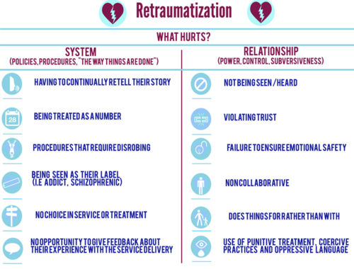
(Institute on Trauma and Trauma-Informed Care, 2015)
TICI of WNY
Notes:
Trainer:
Let me give you an example of how the top two listed on the chart can play out. We’ve all had the experience of going to a new primary care doctor at some point in our lives, right? Generally, you fill out some intake paperwork—either ahead of time or on the clipboard in the waiting room. The paperwork is given to the person at the front desk. Eventually you go back to the exam room and the nurse asks you some similar questions to the paperwork, asking you to elaborate. The nurse leaves, and eventually the doctor comes in. What does the doctor do? [Pause—generally participants will comment that the doctor asks the same questions] Asks the same questions. For anyone, this might be mildly irritating and they may wonder to themselves ‘hello?? Don’t you people talk to each other??’ But, for someone with a history of trauma who has negative cognitions like ‘I don’t matter,’ the continually retelling their story and theme of being unseen and unheard may now flip their lid—and they may not come back.
Retraumatization is a situation, interaction, or environmental factor that replicates events or dynamics of prior traumas and triggers feelings and reactions associated with those original traumas. Thinking about the hand model of the brain we discussed earlier today—re-traumatization is when someone comes into a situation or interaction whole-brained (use your own hand to reinforce the visual), and as a result of experiencing something—tone of voice, non-verbals, something about the physical environment, etc., their lid is now flipped (show hand movement). Or retraumatization can be NOT so obvious, like closing the door of your office thinking you are protecting the consumer’s privacy… while he is being triggered to the times when his teacher used to take him into a room alone and close the door to the room before abusing him. Retraumatization is usually unintentional, most people do not intentionally retraumatize people.
In a system that is not trauma informed – where there lack of knowledge about trauma dynamics, about the trauma history of clients, about how the person was impacted and how he or she has learned to cope -- It is difficult to be sensitive to the ways in which clients can be triggered and retraumatized. Finally Retraumatization is always hurtful – frequently exacerbating the very symptoms that brought the person into services in the first place.
Dr’s Office Example:
For another story on retraumatization, please visit:
theannainstitute.org
Formally known as the Anna Foundation*

Slide 20
Trauma and Adversity have real and significant impacts on…
Individuals
who experience traumatic events.
Service Providers
working with those individuals.
Public Health
as a whole.
TICI of WNY
Notes:
Trainer:
Individuals, service providers, and the public health as a whole are all vulnerable to the effects of trauma.
Individuals: Trauma and adversity have significant impacts on the health and overall quality of life of individuals including early death. Being aware of our own reactions and how this impacts us personally is important as we consider how to best approach someone who has experienced trauma.
Service Providers: The other important piece of talking about trauma is really taking notice of ourselves. We know that the work we do has an impact on us. When considering interacting with individuals who have a trauma story, we know that we, too, are impacted by that story. This is true for any of us who do our work effectively—meaning that we have empathy. We do our work with a bit of an “open heart.” We are “noticing” other. We are allowing ourselves to be impacted by other. Individuals who work as service providers to those who experience trauma may experience vicarious/secondary traumatization in addition to their own trauma. These individuals may be exposed to others’ trauma, causing them to have their own trauma responses. Retraumatization may occur, which is similar to how we must be careful about the trauma we share with others during this presentation. Service providers are uniquely vulnerable to these impacts of trauma. They may develop their own trauma reactions, and these reactions may impact their ability to work with their clients, leading to more stress and anxiety.
Public Health: Trauma is universal, and traumatic events can impact the public health system. Epidemics and pandemics can change the lives of all individuals in a population. These impacts have been correlated to obesity and other diseases as well.

Slide 21
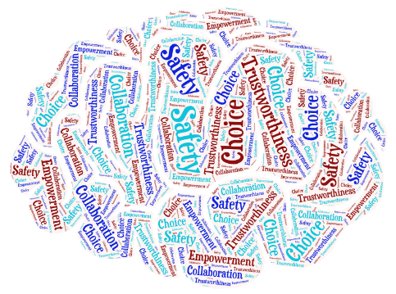
Trauma-Informed Care
We stop asking…
“What is wrong with this person?”
And begin asking…
“What happened to this person?”
TICI of WNY
Notes:
Trainer:
What is the difference between these two questions?
Ask the group how the second question might help
How may the phrasing of the second question help a person more than the first?
This is the Trauma-Informed Care MANTRA. It is about suspending judgment and taking a step back. It is one simple shift in the question we ask and statement we make can help us in our lives and in our work. When we show genuine concern in our interaction, people respond differently. Often in our work, people are not “bad” people doing “bad’ things, they are “hurt” people making “poor” decisions driven by their experience of trauma and their resulting view of themselves and the world.

Slide 22
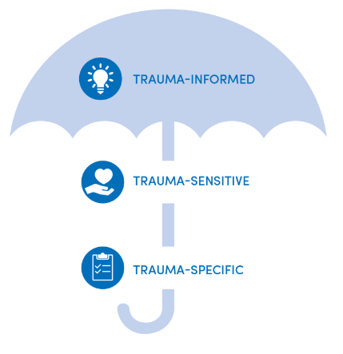
What is your role?
Trauma-Informed:
- Entire community.
Trauma-Sensitive:
- Roles such as teachers, case workers, direct support professionals (DSPs), employers, politicians, job coaches.
Trauma-Specific:
- Licensed Clinical Social Workers (LCSWs), Psychologists, Psychiatrists who are trained in trauma treatment.
(Institute on Trauma and Trauma-Informed Care, 2019)
TICI of WNY
Notes:
Trainer:
How do we provide support that promotes healing from trauma?
If we recognize that many people have been traumatized as children, and we can consider how we approach people within the context of the impact of trauma on the person, we can adjust how we interact based on that fact.
In essence, we create the opportunity for the individual to experience a different response from the world and possibly feel safer and more able to trust. Essentially we need to consider it the Universal Precautions of the work we do.
Trauma Informed applies to all interactions and environment anchored in the 5 values/principles. All staff have received foundational training on trauma/Trauma-Informed Care and it uses universal precautions.
Trauma Sensitive is a decision to use evidence-based trauma screening and assessment tools. There are deliberate changes to environment, policies and procedures to address potential for re-traumatization. Additionally, it is acknowledging impact of the work on staff members.
Trauma Specific is offering evidence-based interventions designed to treat trauma, such as:
Eye Movement Desensitization Reprocessing (EMDR)
Cognitive Processing Therapy (CPT)
Seeking Safety
Trauma-Focused Cognitive Behavioral Therapy (TF-CBT)
What is your role in these interactions?

Slide 23
Trauma-Informed Care
The universal precautions of the work we do.
TICI of WNY
Notes:
Trainer:
At its core, Trauma-Informed Care is a system-wide paradigm shift. Instead of asking, “What is wrong with this person?” It asks all of us—individuals, agencies and organizations--to take a step back and begin asking, “What has happened to this person?”
As we briefly mentioned this morning, being trauma-informed is ensuring “universal precaution.” Similar to how health care professionals put on gloves when in contact with body fluid to prevent the spread of blood borne pathogens—they don’t ask “do you have __?” they just automatically do it just in case, Trauma-Informed Care asks us to put on metaphorical gloves by changing the way we interact with others, changing our policies and procedures, the physical environment, etc. in a way that is sensitive to trauma just in case someone has a history. This is not an intervention that is used only with individuals that we know have a history. This is an approach, a framework that assumes anyone we come in contact with—whether that means the individuals we work with or our colleagues/staff—likely has a history of trauma, so we will engage with them in a way that we know reduces the likelihood of re-traumatization.
It may not be your role or the role of your organization to treat the trauma (trauma-specific). However, you can still have a positive impact by engaging in practices that are trauma-informed and trauma-sensitive—striving to prevent re-traumatization, being sensitive to trauma-related issues and knowing when and where to refer individuals who would benefit from trauma-specific treatments.
Example: If you would picture a lake or a pond… There are often times flat stones. What do people like to do with them? [Pause and allow for response] Skip them. If you are not the trauma therapist, it is your role to skip the stone. If an individual starts to share their story with you, it’s your role to witness and acknowledge, and shift the focus to how are they managing, and/or let me get you connected to someone who is trained to move through these details with you in a way that ensures your safety. When we ask for more details about their history—‘and then what happened?’ or ‘how does that make you feel?’ we are “sinking the stone.” There as a way to do that which is helpful—however it is only the role of those trained in the trauma-specific treatments. There is no “script” for managing these situations. However, it is really important to know that it’s actually more hurtful than helpful to let someone get into all the details of their story when you aren’t trained to ensure their safety—both for that individual, and potentially for yourself.

Slide 24
The Cycle of Trauma
Traumatic Event or Situation
Confirms person’s belief they have no-self worth and world is unsafe.
Sense of worthlessness, inability to trust, anticipation of danger.
People react negatively and respond based on their stereotyped beliefs.
Engages in counter-productive actions or behaviors.
TICI of WNY
Notes:
Trainer:
This illustrates the difficulty individuals have in healing from trauma when those around them do not understand the person’s behavior in the context of trauma, i.e., are not relating to the person in a trauma-informed manner.
We may not be in the role of treating trauma, but we can disrupt it through being trauma-informed and by being intentional in our approach so we aren’t retraumatizing people. It is our responsibility to neutralizing the environment by not making it worse. Its not an intervention. Being trauma-informed is a lens or framework. If we change how we respond, it may be possible to disrupt the cycle.

Slide 25
Five Guiding Principles of Trauma-Informed Care
Safety
Trustworthiness
Choice
Empowerment
Collaboration
(Harris & Fallot, 2001)
TICI of WNY
Notes:
Trainer:
These words are familiar to all of us. It is likely we are utilizing these concepts already. We are going to talk about how they apply to Trauma-Informed Care. This will help us recognize how they are already working and what we can do to introduce them in a new way.
The Five Guiding Principles of Trauma-Informed Care are:
SAFETY, TRUSTWORTHINESS, CHOICE, COLLABORATION, and EMPOWERMENT
These concepts are completely interwoven and interdependent. They are all helpful, but none are sufficient by themselves. No one can trust if they do not feel safe. If someone does not feel empowered, they have difficulty in making choices, even if its one that is positive or attractive to them. To put all of these in play requires the collaboration of a person who understands the role of trauma in a person’s life and serves as an effective partner to them.

Slide 26
Safety
Ensuring physical and emotional safety includes:
Where and when support/services are delivered.
Awareness of an individual’s discomfort or unease.
What other things would things you consider for safety?
TICI of WNY
Notes:
Trainer:
Safety has both physical and emotional dimensions. Physical safety includes considerations about where and when services are offered, what security measures are in place, the physical appearance of waiting rooms, exam rooms, classrooms and offices, whether bathrooms are easily accessible and if there is adequate personal space for patients/clients and staff. Emotional safety includes welcoming, respectful and engaging interactions.
Client Level: Provide environment that allows for personal space, easy accessibility to items that are age appropriate, keep dangerous items away from child.
Workforce Level: Provide an environment that allows for employees to feel safe. Appropriate fire exits, Human Resource and counseling staff available for emotional support. Adequate times for breaks between working.
Community Level: TSA at airports for flight attendants, pilots and passengers. Although, TSA may be an environment where others do not feel safe. TSA provides adequate physical safety, but it may trigger some negative emotions for some due to their invasiveness. This may be negatively impact some individual’s emotional safety based on their trauma history, but a balance is necessary to keep the community safe.
What are other things that you would consider for safety?

Slide 27
Trustworthiness
Ensuring trustworthiness through clarity, consistency, interpersonal boundaries includes:
How to handle dilemmas regarding role clarification.
How to communicate reasonable expectations.
What other areas would you consider important regarding trustworthiness?
TICI of WNY
Notes:
Trainer:
Trust requires honesty, openness, transparency in communications and relationships. Trust creates conditions for healthy attachments.
Client Level: Maintaining confidentiality, providing a consistent routine or structure that helps the individual know what to expect during the interaction.
Workforce Level: Thorough understanding of one’s role in the workplace. Responsibilities are clarified and communication is clear and consistent. Boundaries are maintained
Community Level: Rules and regulations that are consistent among people and populations.
What other areas would you consider important regarding trustworthiness?

Slide 28
Choice
Maximizing choice and control includes:
Participation in decision-making regarding services and life circumstances.
Built in small choices that make a difference.
What kind of choices are relevant to your experiences?
TICI of WNY
Notes:
Trainer:
Individuals who had ACE exposures as a child lived in environments over which they had no control, no choices, and consequently often feel as if they have no choice as to how they live their lives. Life just happened to them, but we can provide a more trauma-informed environment by allowing children and adults some freedom of choice in their lives. On the other hand, too many choices may become overwhelming. Small choices may be necessary in many cases.
Client Level: Offering a child two choices for meals. This gives them the option to choose what they would like to eat, but still maintain some boundaries.
Workforce Level: Offering employees the opportunity to choose when they take a break.
Community Level: Giving the public a chance to vote on their elected officials.
What kind of choices are relevant to your experiences?

Slide 29
Collaboration
Maximizing collaboration and sharing power includes:
Communicating respect for life experience and history.
Communicating respect for individuals being the expert on their own lives.
Identifying tasks that can be worked on together.
In what ways can collaboration be beneficial for the people we come in contact with personally and professionally?
TICI of WNY
Notes:
Trainer:
The principle of collaboration involves creating a space that allows people to have set roles in creating their goals and giving them the opportunity to be the guiding force. We can create collaborative spaces that will benefit everyone.
Client Level: Having a family discussion regarding where they would like to go and how they would like to spend their vacation.
Workforce Level: Company meetings that discuss potential setbacks and problems that individual’s experience and get input from all individuals.
Community Level: Congress or the house or representatives discussing an important issue.
In what ways can collaboration be beneficial for the people we come in contact with personally and professionally?

Slide 30
Empowerment
Prioritizing empowerment and skill building includes:
Ensuring individuals have a voice in planning.
Emphasizing growth.
What can be done to empower individuals?
TICI of WNY
Notes:
Trainer:
Empowerment considers how all interactions and procedures within the system are affirming, validating and build on strengths and skills of individuals. Empowerment can provide the support and encouragement many people need to move forward in their lives in a positive way. We can’t always assume people struggle to do this; empowering people no matter where they are on their journey will be beneficial.
Client Level: Asking a child what they should do next time they get in trouble for being on their phone in class.
Workforce Level: Feedback surveys at the end of a class or training to give the facilitator notes on how the audience believed the class went.
Community Level: Unemployment benefits after someone loses their job. Gives the individual the opportunity to stay afloat while they search for another job.
What can be done to empower individuals?

Slide 31
To commit to becoming trauma-informed is to commit to a new way of thinking.
TICI of WNY
Notes:
Trainer:
Trauma-Informed Care is not about adding more work to our already crazy schedules, or making excuses for the behavior of others, including us. It is, instead, about approaching people and seeing them through a new lens. This lens can allow us to see people in a way that will help us be more thoughtful about our actions, our words, and our ability to provide services.
Trauma informed care is an individualized approach that can make lasting changes to communities, organizations and the culture as a whole.
Trauma informed care may potentially save lives.

Slide 32
Self-Care
Coping Strategies
Stress
Impact of Trauma
Impact of Trauma
Coping Strategies
Self-Care
Stress
Impact of Trauma
Coping Strategies
Self-Care
Notes:
Trainer:
The “UB self-care template” gives examples of ways to take care of oneself when one is feeling unsafe. Some exercises and activities include healthy eating, physical fitness and immunity, reducing stress, time management strategies, relaxation strategies, mindfulness practices, avoiding compassion fatigue, learning assertiveness, and being good to yourself.
It is important to remain balanced in times of stress, and these self-care techniques may help individuals feel safer.

Slide 33
Self-Care
It is important for all of us to practice proper self care to look after our mental health needs.
For more self-care information, visit the page below:
University at Buffalo – School of Social Work
Self Care Starter-Kit
TICI of WNY
Notes:
Trainer:
Self Care information and resources can be found on the University at Buffalo School of Social Work page. This page offers:
1. An introduction to Self-Care
2. Developing a Self Care Plan
3. Self Care assessment, exercises, and activities
4. And additional Self-Care resources

Slide 34
Empathy
Brené Brown on Empathy
Video Link
Drowning in Empathy: The Cost of Vicarious Trauma
| Amy Cunningham | TEDxSanAntonio
Video Link
TICI of WNY
Notes:
Trainer:
The next two videos are surrounding the concept “Empathy”. Empathy is an important aspect facilitating connection between individuals and groups.
Empathy Brené Brown
The first short video is a brief explanation the difference between empathy and sympathy.
Drowning in Empathy: The Cost of Vicarious Trauma | Amy Cunningham | TEDxSanAntonio
This video is a reminder to “Take Ten” or to take care of oneself.
Video Link begins at 9:01, play until end.

Slide 35
Post Traumatic Growth (PTG)
Potential to Grow Through Trauma:
Stress and growth occur together, not one or the other.
Increased ability to manage difficult situations.
May improve relationships following the event. See that those close to you care for you.
Reestablished priorities and new pathways.
No one wants to experience trauma, but it doesn’t always mean negative consequences.
You may become a better you.
TICI of WNY
Notes:
Trainer:
According to Kanako Taku, PhD, associate professor of psychology at Oakland University, Post Traumatic Growth is different than resiliency.
Resiliency is a personal quality that allows someone to bounce back from a difficult situation.
PTG is what can happen when someone who has difficulty bouncing back experiences an event that challenges their core beliefs, causes psychological struggle (even mental illnesses like PTSD), and then finds a sense of personal growth.
The process takes significant time, energy, and dealing with difficult emotions.
A person who is naturally resilient will not have many belief system changes. Those who have less resilience will go through distress and confusion as they try to understand why a terrible thing happened to them, and reevaluate their world view.
Remember “Healing Neen”.

Slide 36
Resources for Trauma, Trauma-Informed Care, and Training Opportunities
The Anna Foundation www.theannainstitute.org
The National Child Traumatic Stress Network (NCTSN) www.nctsnet.org
The Adverse Childhood Experiences Study www.acestudy.org
Ace Response - partnership between Prevent Child Abuse America and the University at Albany (SUNY) School of Social Welfare www.aceresponse.org
Substance Abuse and Mental Health Services Administration www.samhsa.gov
The Institute of Trauma & Trauma-Informed Care at the University at Buffalo School of Social Work www.socialwork.buffalo.edu/ittic
The Trauma Institute & Child Trauma Institute www.childtrauma.com
The Sanctuary Model http://www.sanctuaryweb.com/
TICI of WNY
Notes:
Trainer:
For more information about trauma, trauma-informed care, and trauma-informed training opportunities, please visit:

Slide 37
Local WNY Resources
To find trauma-specific treatment providers, community-based agencies and other resources in Western New York please visit:
https://ticiwny.org/directory/
“Anything that’s human is mention-able, and anything that is mention-able can be more manageable. When we can talk about our feelings, they become less overwhelming, less upsetting, and less scary. The people we trust with that important talk can help us know that we are not alone.”
― Fred Rogers
TICI of WNY
Notes:
Trainer:
Local Resources
There is a link to resources on the TICI directory which offers trauma-specific treatment providers, community-based agencies and other resources.
For people out of state, this link goes right to directory, however if you are outside of NYS here you can place local resources here.
Below are some Buffalo NY resources:
Crisis Services (Erie County)
100 River Rock Drive – Suite 300
Buffalo, NY
Crisis Hotline: (716) 834-3131
Addiction Hotline: (716) 831-7007
Niagara County Crisis Services
5467 Upper Mountain Road – Suite 200
Lockport, NY
(716) 285-3515
Horizon Health Services (Bailey Recovery Center)
3020 Bailey Ave, Buffalo, NY
(716) 833-3622
Spectrum Human Services (Mental Health Urgent Care)
1280 Main St, Buffalo, NY
(716) 539-6743
Child and Family Services
330 Delaware Ave., Buffalo, NY
(716) 842-2750

Slide 38
References
Acestudy.org. (2020). Retrieved from http://www.acestudy.org/
Koury, S. (2020) AIDS institute and Cazenovia Recovery Services, Inc presentations.
Bal, R. (2020). The Fight Flight Freeze Fawn Responses and The Pitfalls of Empathy. Retrieved from https://rolandbal.com/fight-flight-freeze-fawn/
Barish, K. (2020). Review of Against empathy: The case for rational compassion. The Humanistic Psychologist. https://doi.org/10.1037/hum0000181
Brainline. (2019). Growing Through Trauma. Retrieved from https://www.brainline.org/article/growing-through-trauma
CDC. (2020). Adverse Childhood Experiences (ACEs). Retrieved from https://www.cdc.gov/violenceprevention/acestudy/
Collier, L. (2016). Growth after trauma. Retrieved from https://www.apa.org/monitor/2016/11/growth-trauma
“Creating Cultures of Trauma-Informed Care: A Self-Assessment and Planning Protocol” by Roger D. Fallot, Ph.D. and Maxine Harris, Ph.D. Community Connections, April 2009
CrownHeightsCo. (2020). Healing Neen: The Tonier Cain Documentary. Retrieved from http://healingneen.com/
“Early Childhood Adversity, Toxic Stress, and the Role of the Pediatrician: Translating Developmental Science into Lifelong Health.” American Academy of Pediatrics January 2012 Policy Statement
Gillson, S. L., & Ross, D. A. (2019). From generation to generation: Rethinking “soul wounds” and historical trauma. Biological Psychiatry, 86(7), e19–e20. https://doi.org/10.1016/j.biopsych.2019.07.033
NASMHPD. (2019). National Association of State Mental Health Program Directors. Retrieved from http://www.nasmhpd.org/
SAMHSA. (2018). Criminal Justice Training Version 3.1. Retrieved from https://www.prainc.com/trauma-informed-training/training-materials/criminal-justice-training-v3-1/
Southern Poverty Law Center. [splcenter]. (2017) 12 years to the day after Hurricane Katrina, reporters must still be aware of implicit bias. #HurricaneHarvey
“Trauma-Informed Care” – PowerPoint presentation by Elizabeth Hudson, LCSW, Consultant to the Wisconsin Dept. of Health Services, Division of Mental Health and Substance Abuse Services
Working together to promote trauma informed relationships and practices. (2020). Retrieved from http://www.trauma-informed.ca/
Slide Formatting and Facilitator Notes were created in collaboration with members of TICI WNY Tom Dodson, Sue Green, Travis Hales, Samantha Koury and Dean Squires Jr. http://ticiwny.org
TICI of WNY

